Slide 2
IPEDS Workshop 2017
IPEDS Team

Slide 3
IPEDS Workshop Agenda
IPEDS Team
Notes from 2016-17 Data Collection
2017-18 Data Collection
IPEDS Research & Development Activities
IPEDS Data Release and Publications
Resources
IPEDS Use the Data Tools

Slide 4
IPEDS Team

Slide 5
Staff at NCES
Peggy Carr | Acting Commissioner, National Center for Education Statistics
Ross Santy | Associate Commissioner, Administrative Data Division
Richard Reeves | Branch Chief, Postsecondary Administrative Data Branch
Samuel Barbett | Data Quality & Dissemination Team Lead
Tara Lawley | Data Operations Team Lead

Slide 6
Staff at NCES
Aida Aliyeva | 12-Month and Fall Enrollment
Chris Cody | Academic Libraries and Institutional Characteristics
Moussa Ezzeddine | Universe; IC-Header; Admissions; Data files; Data integration
Gigi Jones | Outcome Measures; Data Feedback Report; National Postsecondary Education Cooperative; Technical Review Panels
Bao Le | Finance and Student Financial Aid
Andrew Mary | Graduation Rates and Graduation Rates 200; Publications
Imani Stutely | Human Resources and Completions; SOC
Jie Sun | SAS programming

Slide 7
IPEDS Contractor Staff
RTI International
Amy Barmer, IPEDS TRPs, IPEDS Help Desk
Jamie Isaac, Associate IPEDS Project Director, Help Desk Manager
Janice Kelly-Reid, IPEDS Project Director
Association for Institutional Research (AIR)
Tinsley Smith, Director of Contracts and Grants

Slide 8
Notes from 2016-17 Data Collection

Slide 9
Reporting noncompliance and one last chance
Tara Lawley
Notes from 2016-17 Collection

Slide 10
Reporting Noncompliance
The regulations permit a fine of up to $35,000 for each violation of any provision of Title IV, or any regulation or agreement implementing that Title
Remember, noncompliance encompasses both timely and accurate reporting

Slide 11
Response Status
Keyholder close date was Wednesday, 4/12
Help Desk is now working with KHs who did not lock on time
One Last Chance
Minor edit problems
Coordinator close date was Wednesday, 4/26

Slide 12
One Last Chance Policy
Allows institutions one chance to submit data after the deadline
After due date, Help Desk contacts institutions that have not already used OLC
They are given 2 weeks
Help Desk enters, edits, works w/ keyholder to get data clean and locked

Slide 13
One Last Chance Policy
Institutions that have used OLC are not contacted
If institution contacts Help Desk, they are given 24 hours to submit the data
Most institutions using OLC are non-coordinated

Slide 14
Origins of changes
Tara Lawley
Notes from 2016-17 Collection

Slide 15
Origins of Changes
Technical Review Panels (TRPs; available at https://edsurveys.rti.org/IPEDS_TRP/Default.aspx):
NCES review
Feedback from the Library community
Public comments

Slide 16
Institutional Characteristics (IC)
Chris Cody
Notes from the 2016-17 Collection

Slide 17
Registration/Identification
DUNS numbers
Added question to collect DUNS numbers on Institutional Identification Page
If your institution has an assigned Dun and Bradstreet number (DUNS) please enter your institution’s DUNS or DUNS + 4 number(s).

Slide 18
Registration/Identification
Disability Services
Added a box to collect Disability Services web address

Slide 19
IC Header
Screening Question
New (additional) library screening question added to Part C – Other Survey Screening Questions – Library Access and Expenses

Slide 20
IC: Part C – Student Services
Other Student Services
Replaced library resources question below with new question (next screen)
Old Library Resources Question:

Slide 21
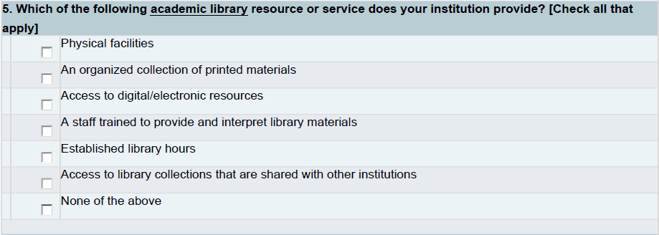
IC: Part C – Student Services
Other Student Services
New Library Resources Question

Slide 22
IC: Part C – Student Services
Distance Education Opportunities
New distance education screen with new distance education screening question and other distance education questions:
Do your institution offer distance education courses?
Are all of the programs at your institution offered exclusively via distance education?
Please indicate at what level(s) your institution offers distance education opportunities (courses and/or programs).

Slide 23
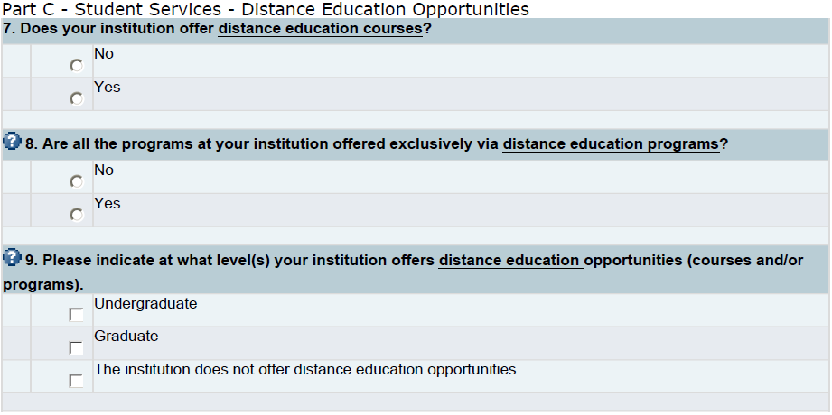
IC: Part C – Student Services
Distance Education Opportunities
New distance education questions:

Slide 24
Changes: Outcome Measures
Gigi Jones
Notes from the 2016-17 Collection

Slide 25
Outcome Measures - Study Abroad
Institutions no longer need to exclude any student studying abroad (e.g., at a foreign university) if their enrollment at the 'home' institution serves as an administrative record and students in any branch campus located in a foreign country

Slide 26
OM 8 years: No Revisions, but Additional Exclusions
The column for revisions on the 8 year screen was deleted
Institutions can report additional exclusions since the six year status date through the eight year status date
For the 2016-17 collection, the additional exclusion period is September 1, 2014 through August 31, 2016

Slide 27
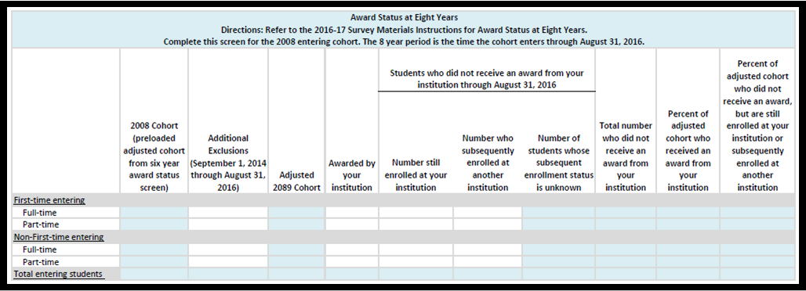

Slide 28
OM 6 years: FTFT Consistency
First year of OM collection (2015-16)
Mis-matched FTFT for OM when compared to GR200 and GR FTFT.
For 2016-17, institutions with prior reported FTFT cohort data from GR and GR200 cannot revise their FTFT data on OM.
Instead, FTFT cohort data reported earlier on GR will be preloaded.

Slide 30
2016 Prior Year Revision: Email Outreach
Emails were sent to approx. 1,300 institutions and affected coordinators to revised their 2015-16 OM data
2-yrs with inconsistent OM and GR200
4-yrs with BA-completers only but inconsistent OM/GR/GR200 data
4-yrs with inconsistent OM and GR data
No completers reported
No transfer out data reported
No transfer out data reported but reported to GR

Slide 31
Technical Paper
NCES believed institutions would revise their data
Most of the 2015-16 data were not revised and locked
The release of the 2015-16 data will not have accompanying First Look because the data are final
Instead, a technical paper will be written documenting the efforts to clean the data and identifying the institutions that did not revise and relock their OM 2015-16 data

Slide 32
Changes: Graduation Rates
Andrew Mary
Notes from the 2016-17 Collection

Slide 33
GR: New Question on Pell Recipients
Added a question to ask for the number of students in a subcohort, exclusions, and completers within 150% of normal time for certain financial aid groups:
Recipient of a Pell Grant
Recipient of a subsidized Stafford Loan but NO Pell grant
Received neither a Pell Grant or subsidized Stafford Loan

Slide 34
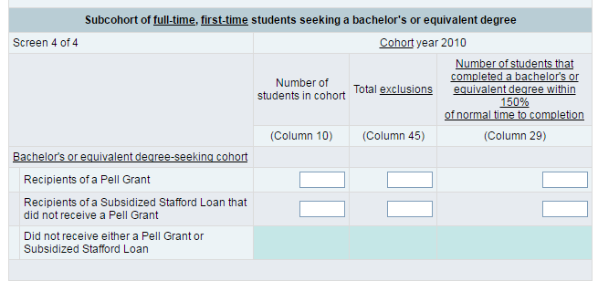
GR: New Question on Pell Recipients
Similar question was added to the 4-year and 2-year GR form

Slide 35
Changes: Graduation Rates 200 (gr200)
Andrew Mary
Notes from the 2016-17 Collection

Slide 36
GR200: New Screening Question
Your institution reported to the GR survey component as having the following number of students who did not complete, but were still enrolled at your institution: (preload the number reported from GR)
Did you have students who received an award between 151% and 200% of the normal time to complete? (Y/N)

Slide 37
Changes: Admissions (ADM)
Moussa Ezzeddine
Notes from the 2016-17 collection

Slide 38
Deleted: ‘Don’t know’ Column
‘Don’t know’ was removed as an option for describing how an institution uses any of the following data in its undergraduate selection process:
Secondary school GPA
Secondary school rank
Secondary school record
Completion of college-preparatory program
Recommendations
Admission test scores
SAT/ACT
Other test (ABT, Wonderlic, WISC-III, etc.)
TOEFL
Formal demonstration of competencies (e.g., portfolios, certificates of mastery, assessment instruments)
Notes:
We used to ask data providers to report “Don’t Know” for admission considerations if they do not know if certain admission criteria are required, recommended, or neither required nor recommended for their institution. To enable data providers to show a more accurate representation of their institutions’ admission criteria, we eliminated the “Don’t Know” option for admission considerations.

Slide 39
Added: ‘Considered but not required’ Column
‘Considered but not required’ was added as an option for describing how an institution uses any of the following data in its undergraduate selection process:
Secondary school GPA
Secondary school rank
Secondary school record
Completion of college-preparatory program
Recommendations
Admission test scores
SAT/ACT
Other test (ABT, Wonderlic, WISC-III, etc.)
TOEFL
Formal demonstration of competencies (e.g., portfolios, certificates of mastery, assessment instruments)

Slide 40
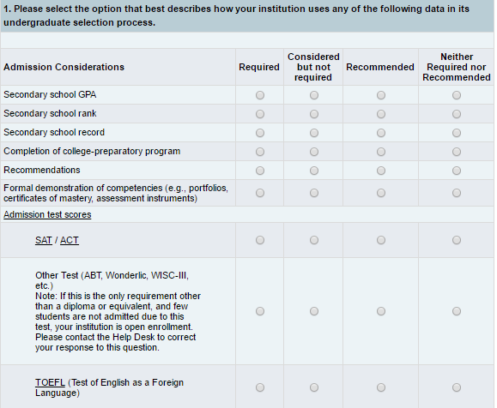

Slide 41
Writing Scores
Writing scores are no longer reported for ACT and SAT

Slide 42
Instructions for SAT scores
SAT Redesign
SAT critical reading and math scores were reported based on the old (2015) SAT score range.
Institutions that had scores based on the new (2016) SAT score range converted scores using the College Board concordance tables.

Slide 43
Changes: Student Financial Aid (sfa)
Bao Le
Notes from the 2016-17 collection

Slide 44
Context Boxes
Added preloaded contexts for users to explain their data
Each context box had different explanations
No issues with implementation

Slide 45
Changes: Fall enrollment (ef)
Aida Aliyeva
Notes from the 2016-17 Collection

Slide 46
Fall Enrollment: Retention Rates
The retention rate is calculated as:
(Students from the Fall 2016 cohort still enrolled as of Fall 2017/Adjusted Fall 2016 cohort)*100

Slide 47
Fall Enrollment: Retention Rates
(New!) Inclusions:
First-time degree/certificate-seeking study abroad undergraduates who were excluded from the first-time cohort but have re-enrolled at the institution their second year

Slide 48
Fall Enrollment: Retention Rates
New

Slide 49
Fall Enrollment: FAQs
(New!) FAQ My Institution’s freshman study abroad students were excluded from the prior year first-time enrollment count. How can I add these students back into the prior year’s first-time cohort for the current year’s retention calculation?
Freshman study abroad students can be added to the first-time cohort. Report in the inclusion box first- time degree-/certificate-seeking study abroad students who were excluded from the first-time cohort but who have re-enrolled at the institution their second year.

Slide 50
Fall Enrollment: FAQs
(New!) FAQ Sophomore study abroad students have been excluded from my fall enrollment count because they are taking classes in foreign country. How can I include them as part of my retention calculation?
Sophomore study abroad students are considered part of the retained cohort even though they may not be included in the institution’s fall enrollment count. Count these students in the retained cohort.

Slide 51
Changes: Human Resources (HR)
Imani Stutely
Notes from the 2016-17 Collection

Slide 52
All versions of HR form
Race/Ethnicity
Collected every other year until the 2016-2017 collection:
Mandatory in even years
Optional in odd years
**Mandatory every collection year 2016-2017 onward**

Slide 53
Degree-granting institution forms
Salary outlays
Collected separately by contract length/employment agreement (9-, 10-, 11-, 12-months)
Salary headcounts
Collected headcount of FT instructional staff on contract/employment agreements of less than 9 months by gender and academic rank

Slide 54
Degree-granting institution forms
Graduate Assistants
Implemented new, condensed categories specifically for graduate assistants:
Graduate assistant, teaching;
Graduate assistant, research; and
Graduate assistant, other.
New Hires
Revised the reporting period for new hires to include any newly hired, full-time, permanent staff on the payroll of the institution between November 1 and October 31
**The “As of November 1, 2016” requirement for reporting New Hires was eliminated for the 2016-2017 collection**

Slide 55
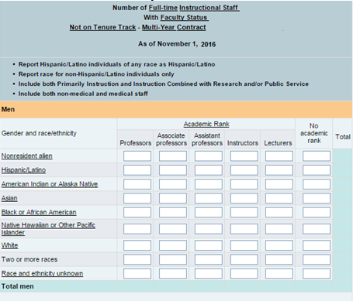
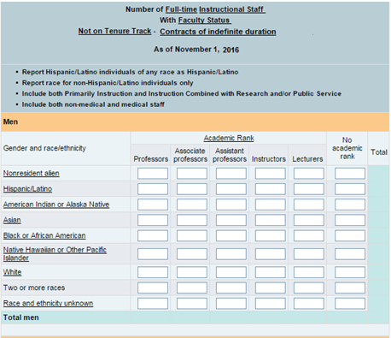
Degree granting institutions with 15+ staff forms
For employment agreement/contract length
Added separate employment agreements of indefinite length from multi-year employment agreements

Slide 56
changes: academic libraries
Chris Cody
Notes from the 2016-17 Collection

Slide 57
Section I
Added “serials” row to Library Collections, and included “serials” in the count for physical circulation (not digital/electronic)
Added a y/n question to determine if institution has interlibrary services
Moved interlibrary questions from Section II to Section I

Slide 58
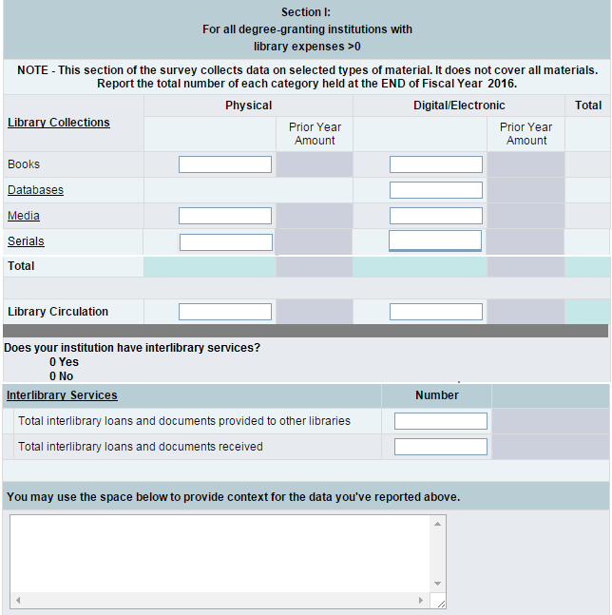
Section I

Slide 59
Section I
Serial Definitions:
A serial is a publication in any medium issued in successive parts bearing numerical or chronological designations and intended to be continued indefinitely. This definition includes, in any physical format, periodicals, newspapers, and annuals (reports, yearbooks, etc.); the journals, memoirs, proceedings, transactions, etc. of societies; and numbered monographic series.
An e-serial is a periodical publication that is published in digital form to be displayed on a computer screen.

Slide 60
Section I
Instruction Changes
Updated Instructions to the followings sections:
Physical Books
Physical Media
Serials
Physical Circulations
Digital/Electronic Books
Digital/Electronic Serials
Digital/Electronic Circulations/Usage

Slide 61
Section II
Deleted the interlibrary loans questions (moved to Section I)
Deleted the question: Does your library support virtual reference services?

Slide 62
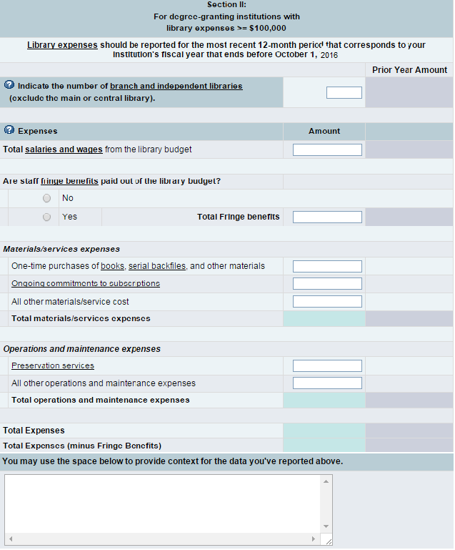

Slide 63
Section II
Instruction Changes
Updated Instructions to the followings sections:
One-time purchases of books, serial back-files, and other materials
Ongoing commitments to subscriptions
Other materials/service cost based
All other operations and maintenance expenses

Slide 64
Changes: Finance
Bao Le
Notes from the 2016-17 Collection

Slide 65
All Forms: Expense screen
Expense matrix was eliminated
Expense by functional and natural classifications were reported separately
Less reporting of detail
Operation and Maintenance of Plant had to be excluded from Salaries and Wages and other natural classifications

Slide 66
All Forms: Expenses by Functional Classification

Slide 67
All Forms: Expenses by Natural Classification

Slide 68
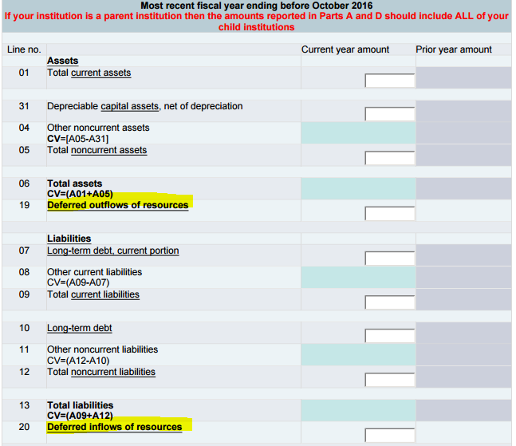
GASB Form: Financial Position
Deferred outflows / inflows added

Slide 69
GASB Form: Pension screen
Revised screening question to “Does your institution include pension liabilities, expenses, and/or deferrals for one or more defined benefit pension plans in its Statement of Revenues, Expenses, and Changes in Net Position?”
Institutions reported on pension expense/liability instead of “additional” pension expense/liability related to GASB 68 and 71

Slide 70
GASB Form: Census screens
Revenue data (instructions only)
Revised Gifts and Private Grants to exclude capital contributions
Expenditure data
Removed fields for salaries and wages
Employee benefits were no longer preloaded but instead reported for the following functions:
Auxiliary enterprises
Hospitals
Removed fields for scholarships and fellowships
Debt and assets data (instructions only)
Long-term debt included all debt issued in the name of the institution
Assets can include bond funds established by parent state or local government

Slide 71
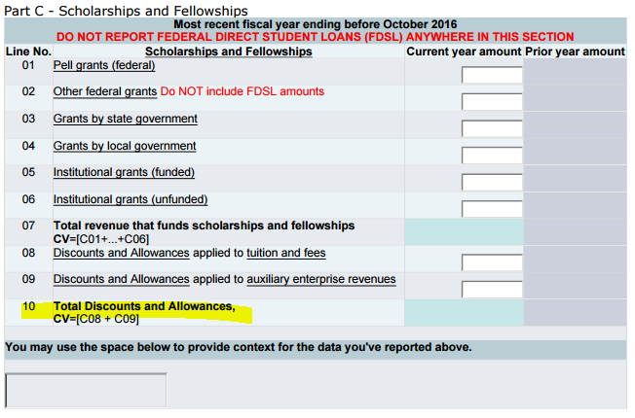
FASB Forms: Added Total Discounts

Slide 72
2017-18 Data Collection

Slide 73
schedule
Tara Lawley
2017-18 Data Collection

Slide 74
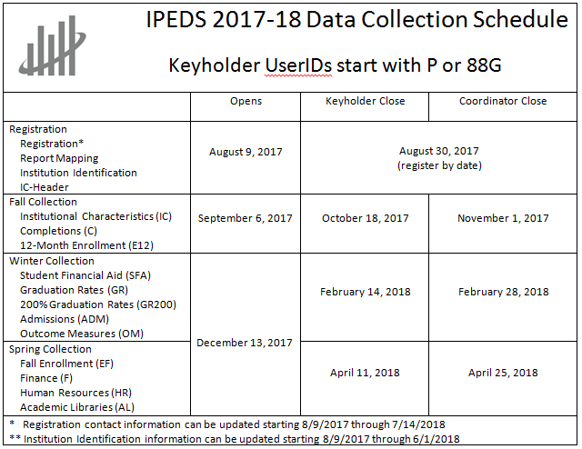

Slide 75
Registration Review Date
Register by 8/30 – coordinators, too!
If a keyholder has not registered as of this date, a letter will be sent to the CEO requesting appointment of a new keyholder
If coordinators don’t register, we have to hunt you down. Only registered coordinators are invited to this conference….

Slide 76
Prior Year Revision (PYR) System
Survey components will be open for revision during their regular data collection period
EXCEPT: Fall components will open on 9/13 instead of 9/6
Revise cost of attendance data on IC or any SFA data through current year SFA, NOT in PYR

Slide 77
Other Important Dates
Update Registration Contact information
8/9/17 – 7/14/18
Update Institution Identification information
8/9/17 – 6/1/18
Upload Custom Comparison Group for 2015 Data Feedback Report
2/1/18 – 7/14/18

Slide 78
Changes
Tara Lawley
2017-18 Data Collection

Slide 79
OMB Clearance
The IPEDS 2017-18 through 2019-20 (1850-0582 v.20) package is approved for collection.
The new expiration date is 2/29/2020.
There will be a memo to OMB in the summer that will cover any new FAQs, etc., since the package was approved.

Slide 80
Origins
Changes mostly based on:
Technical Review Panels
Quality control work,
Work with interested organizations, and
Feedback from institutions.

Slide 81
Institutional Characteristics (IC)
Chris Cody
2017-18 Collection

Slide 82
IC: Part C – Student Services
Distance Education Opportunities
Combine two of the 2016-17 distance education questions on courses and programs into one.
Do your institution offer distance education courses?
Please indicate at what level(s) your institution offers distance education opportunities (courses and/or programs).

Slide 83
IC: Part C – Student Services
Distance Education Opportunities
2016-17 distance education questions:

Slide 84
IC: Part C – Student Services
Distance Education Opportunities
2017-18 distance education questions:
7. Please indicate at what level(s) your institution offers distance education courses and/or distance education programs. Check all that apply.
 |  |  | Distance education courses | Distance education programs
Undergraduate level |  |  |  | 
Graduate level |  |  |  | 
The institution does not offer distance education at the undergraduate or graduate level. |  |  |  | 
8. Are ALL of the programs at your institution offered exclusively via distance education programs?
 |  | Yes
 |  | No

Slide 85
Changes: Outcome Measures
Gigi Jones
2017-18 Collection

Slide 86
Outcome Measures and Pell
Currently, institutions are required to disclose their Pell Grant recipients graduations rates on their website
ED is unable to immediately and annually produce a federal graduation rate for Pell recipients for the Administration or Congress
For accountability and transparency reasons, a Pell cohort has been added to the OM
Starting collection year: 2017-18
Entering cohort year: 2009

Slide 87
Approved OM 2017-18 Changes
1) All academic institutions will report on a full-year cohort, defined as July 1-June 30.
For academic year institutions, this is a departure from defining cohorts based on the official Fall reporting period (census date).
Students remain in the cohort assigned upon entry.
2) Each of the four OM cohorts will have a Pell Grant recipient sub-cohort.
Four cohorts are: first-time full-time; first-time part-time; non-first-time full-time; non-first-time part-time.
Pell recipients are identified at entry. If a student receives a Pell Grant after entry they are not included in the Pell cohorts.
Non-Pell Grant recipients will be calculated from the cohort total.

Slide 88
Approved Changes (cont.)
3) Institutions will report on three status years: 4 years, 6 years, and 8 years.
4-years is a new status year.
Award status for each status year are mutually exclusive.
4) Institutions will report on the highest award conferred (certificate, associates or bachelors) for each of those status years.
Previously only reported that a student received “any” award

Slide 89
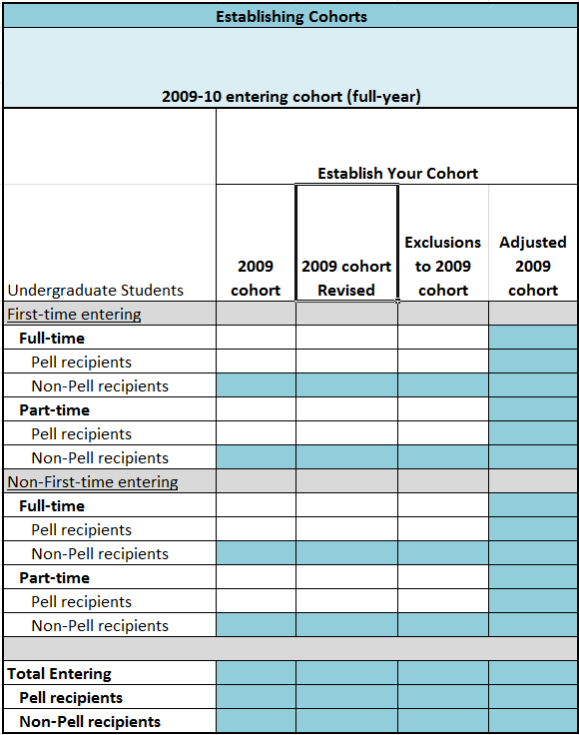
1st Screen: Establishing Cohort Numbers
No preloaded data for 4 cohorts or 4 sub-Pell cohorts
4 sub-non Pell cohorts and Total Entering will be calculated
Based on a full-year entry between July 1, 2009 to June 30, 2010

Slide 90
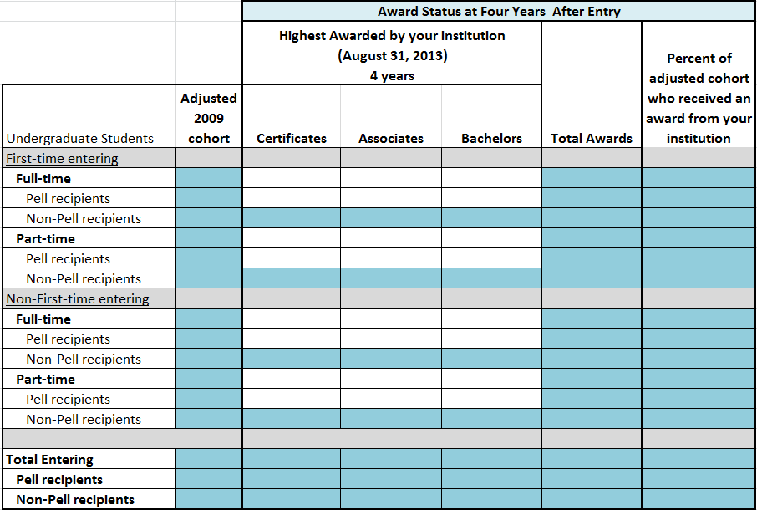
2nd Screen: 4 Years

Slide 91
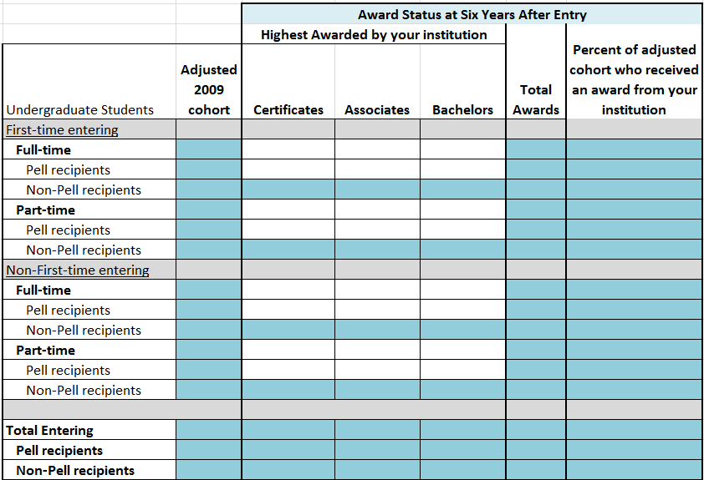
3rd Screen: 6 Years

Slide 92
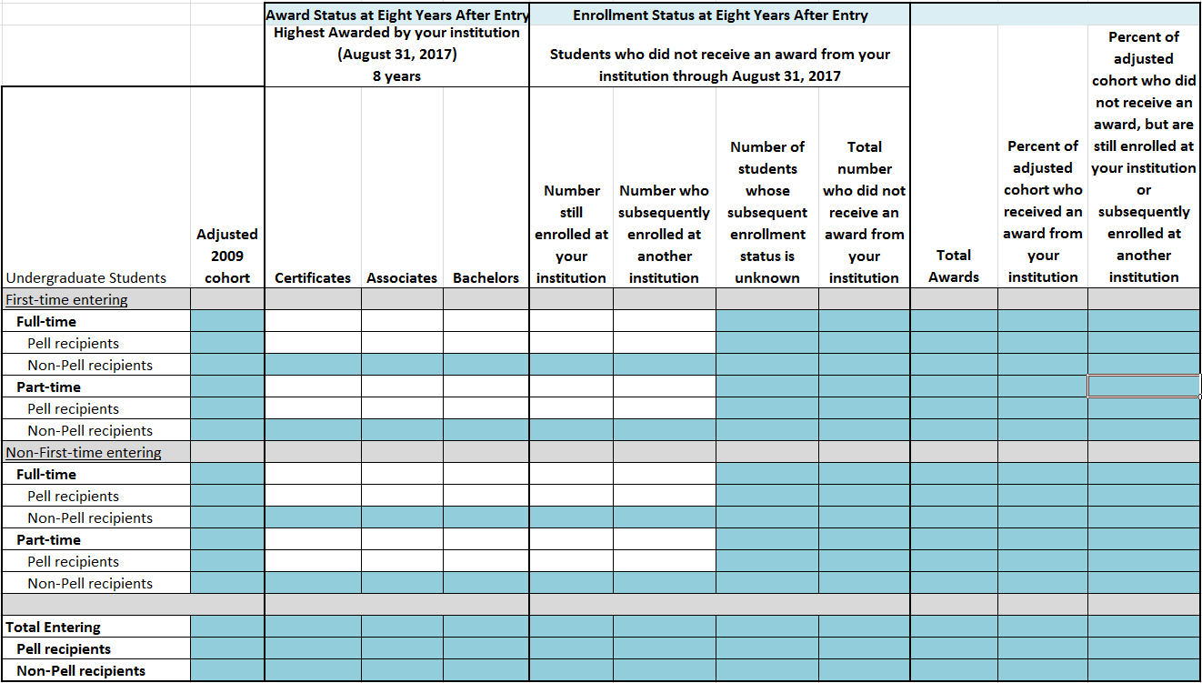
4th Screen: 8 Years

Slide 93
Additional Instructions: Full Year
CHANGED. Institutions that offer a predominant number of programs based on standard academic terms (semesters, trimesters, quarters, or 4-1-4 plan) are considered academic reporters and will report using a full-year cohort of students. Do not use a fall cohort. These institutions must count as entering students all those students who entered the institution between July 1, 2009 and June 30, 2010.
NO CHANGE. Institutions that do not offer a predominant number of programs based on standard academic terms (as defined above) are considered either program or hybrid reporters and will report using a full-year cohort. These institutions must count as entering students all those students who entered the institution between July 1, 2009 and June 30, 2010, and who were enrolled for at least 15 days in a program of up to, and including, one year in length, or 30 days in a program of greater than one year in length.

Slide 94
Pell Grant Sub-Cohorts
Institutions will identify and include Pell Grant recipients who received a Pell Grant between the cohort coverage period of July 1, 2009 and June 30, 2010.
Students who did not receive a Pell Grant during the cohort coverage period, but receive a Pell Grant July 1, 2010 through August 31, 2017 (outside of the established cohort coverage period) are not included in the Pell Grant sub-cohorts.
Students who received a Pell Grant (dollars disbursed) are included in the Pell Grant sub-cohorts. Institutions should not include students who were awarded a Pell Grant, but did not receive a disbursement.

Slide 95
Award Status
For each award status year (4, 6, and 8 years):
All students entering in 2009-10 should be included in one of these four cohorts
Report each student only once
Awards are mutually exclusive from other time points
Highest Award
For each cohort at the 4- and 6-year status points, report the highest award (i.e., certificate, associates, or bachelors) conferred by your institution even if the student was still enrolled at your institution or had transferred to another institution.
If students earned multiple awards by the end of a time point, count the student once and report the highest award conferred
DO NOT include graduate awards conferred to undergraduate students.

Slide 96
Deleting FAQs
#8. Q: How do I count students who enrolled during the prior summer?
# 9. What about spring cohorts? Should students who enroll during the spring be included?
# 10. My institution changed our calendar system since the cohort was originally reported (e.g., we were a program reporting institution in 2008, but then became an academic year reporting institution a couple years later). Which calendar system does my institution report on (program or academic)?
# 15. If I am a program or hybrid reporter, how do I report students who begin at my institution as non-degree/certificate-seeking students, but the following year they become degree/certificate-seeking?

Slide 97
Modifying FAQ 14
# 14. Q: How do I report students who enter my institution as non-degree/certificate-seeking students in the fall, but enroll as degree/certificate- seeking students during the cohort year?
For academic year reporters, A: Include these students in your full-year cohort. do not include these students in any of the fall cohorts because the students did not enter at that same institution as degree/certificate-seeking students during the reporting period. For example, if the student enters an institution the fall of 2008 as non-degree/certificate-seeking, but then becomes degree/certificate-seeking at the same institution the following spring, this student should not be included in either fall 2008 cohort (OM collection 2016-17) or the following fall cohort for the next IPEDS collection cycle. For the 2016-17 OM collection, the reporting period for academic year reporters is either as of October 15, 2008, or the institution’ s official fall census date. For the 2017-18 OM collection, the reporting period covered for program or hybrid reporters is July 1, 2009, to June 30, 2010.

Slide 98
changes: Admissions
Moussa Ezzeddine
2017-18 Collection

Slide 99
Instructions for SAT scores
SAT critical reading and math scores should be reported based on the new (2016) SAT score range.
Institutions that have scores based on the old (2015) SAT score range should convert scores using the College Board concordance tables.

Slide 100
Changes: Student financial aid
Bao Le
2017-18 Collection

Slide 101
Reporting Military Education Benefits
SFA collects the number of beneficiaries and the total amount of benefits under:
Department of Veterans Affairs Post-9/11 GI Bill (including Yellow Ribbon program)
Department of Defense Tuition Assistance Program (DOD TAP)
Amounts are reported by undergraduate and/or graduate level
Maximum amount of DOD TAP reimbursements = $4500/student/fiscal year
Institutions are reporting values greater than $4500/student
Financial aid office find it challenging to separate types of military aid

Slide 102
Reporting Military Education Benefits
NCES will add:
FAQ to provide guidance for reporting DOD TAP
Prior year values to enhance data quality checks

Slide 103
FAQ
The SFA survey indicates that the maximum amount of DOD TAP awarded per fiscal year per student is $4500. What do I do if my DOD TAP average is greater than $4500 per student?
According to the 2014 final regulations set for the DOD Voluntary Education Programs - which include TAP (https://www.regulations.gov/document?D=DOD-2013-OS-0093-0048) - each branch of military service can pay no more than $250/semester-unit (or equivalent) for tuition. Each service member is eligible for up to $4500 in aggregate for each fiscal year. If your institution’s DOD TAP average is greater than $4500 per student per award year, then you should:
Ask your financial aid office or VA certifying official to sort out the military aid and remove any non-DOD TAP aid (e.g., ROTC scholarships, tuition reimbursements for advanced civil schooling, education-related incentive or bonus);
Remove any non-Title 10 aid since TAP is a Title 10 program; and
Make sure that you are including one disbursement period for that award year. Even though DOD TAP aid are reported for the Oct 1 – Sep 30 timeframe, which technically covers two fall periods; only include one fall disbursement period per award year.

Slide 104
Adding PY Values to Military Assistance
 |  |  |  | Your Prior Year Amount
Type of benefit/assistance | Number of students receiving benefits/assistance | Total dollar amount of benefits/assistance awarded through the institution | Average dollar amount of benefits/assistance awarded through the institution | Average dollar amount of benefits/assistance awarded through the institution
Post-9/11 GI Bill Benefits
Undergraduate students
Graduate students
Total
Department of Defense Tuition Assistance Program
Undergraduate students
Graduate students
Total

Slide 105
Changes: Human Resources
Imani Stutely
2017-18 Collection

Slide 106
Degree-granting institution forms: Head Counts (G1)

Slide 107
Degree-granting institution forms: Salary Outlays (G2)

Slide 108
Changes: finance
Bao Le
2017-18 Collection

Slide 109
All Forms: Clarification on O&M Expenses
For both FASB (public and private) and GASB (public) institutions, instructions on how to report Operations and Maintenance of Plant (O&M) expenses will be clarified
Do NOT include O&M expenses in Salaries and Wages, Benefits, Depreciation, Interest, or Other Natural Expenses because O&M expense is reported in its own separate natural classification category.

Slide 110
All Forms: Clarification on O&M Expenses

Slide 111
GASB Forms: Clarification for Pension
Guidance will be added for institutions with jointly audited financial statements
Pension screening question
System offices absorbing all the pension expenses, liabilities, and deferrals for all their campuses should answer “Yes” to the screening question and the campuses should answer “No”

Slide 112
GASB Forms: Clarification for Pension
Guidance will be added for institutions with jointly audited financial statements
Part M
Institutions that share audited financials with another entity (e.g., with districts, high schools, hospitals, etc.) should report only its proportionate share of pension expense, liability, and deferrals

Slide 113
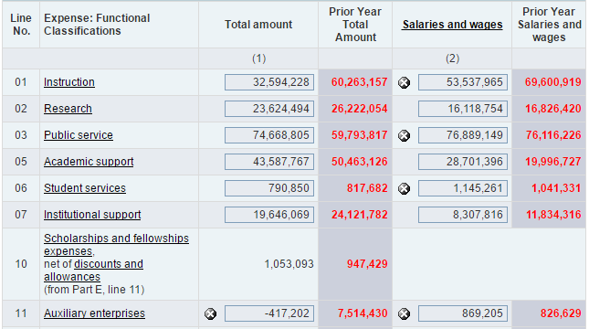
GASB Forms: Pension Expenses
Pension expenses are creating volatility in the functional expense categories

Slide 114
GASB Forms: Pension Expenses
Guidance will be added to instruct institutions to allocate pension expenses to
Other Functional Expenses (Part C-1)
Benefits Expenses (Part C-2)
Allocating the pension expense to two distinct categories will reduce the volatility across all categories

Slide 115
IPEDS Research and Development Activities

Slide 116
IPEDS Technical Review Panel
Janice Kelly-Reid, RTI International
IPEDS Research and Development Activities

Slide 117
What is the IPEDS Technical Review Panel?
Group of technical experts that meets ~3x/yr to:
Implement legislation and regulations into IPEDS
Address emerging areas of concern
Decrease reporting burden AND retain federal data necessary for policy making and analysis
Meetings are conducted by RTI International

Slide 118
Technical Review Panel Website
Hosted by RTI
Summaries of meetings
Calls for comment and
Dates for upcoming meetings
Available through the Technical Review Panel link on the ‘Join In’ page
Contact Janice Kelly-Reid at jrk@rti.org if interested in serving

Slide 119
Technical Review Panel Website

Slide 120
Recent TRP Meetings
Date | TRP Topic
July 2016 | The Public Face of IPEDS
August 2016 | Outcome Measures 2017-18
October 2016 | Gender
March 2017 | 2017 Subbaccalaureate Certificates

Slide 121
Upcoming TRP Meetings
Date | TRP Topic
June 2017 | Distance Education
October 2017 | TBD

Slide 122
National postsecondary education cooperative
Gigi Jones
IPEDS Research and Development Activities

Slide 123
NPEC Members
Promote the quality, comparability and utility of postsecondary data and information that support policy development at the federal, state, and institution levels
Participate on the IPEDS Technical Review Panel
Serve on/lead working groups to explore targeted Research & Development topics

Slide 126
R&D Topics and Reports
NPEC has commissioned papers to inform the its mission of improving postsecondary data and information.
Currently under internal review: the Updated 2012 “The History and Origins of Survey Items for the IPEDS”
FY16, NPEC members commissioned four papers:
Subbaccalaureate certificates
Dual Enrollment
Distance Education
Better Finance Metrics

Slide 127
Resources

Slide 128
Coordinator tools in data collection system
Tara Lawley
Resources

Slide 129
See Coordinator Handbook
for more details

Slide 130
See Coordinator Handbook
for more details

Slide 131
IPEDS Help Desk
Tara Lawley
Resources

Slide 132
Help Desk
RTI International manages the two IPEDS Help Desks
Data Collection Help Desk
Tools Help Desk
The Help Desk provides outstanding service as expert representatives
8:30am-5:00pm Eastern
Additional weeknight and weekend hours offered during the final 10 days of each data collection period

Slide 133
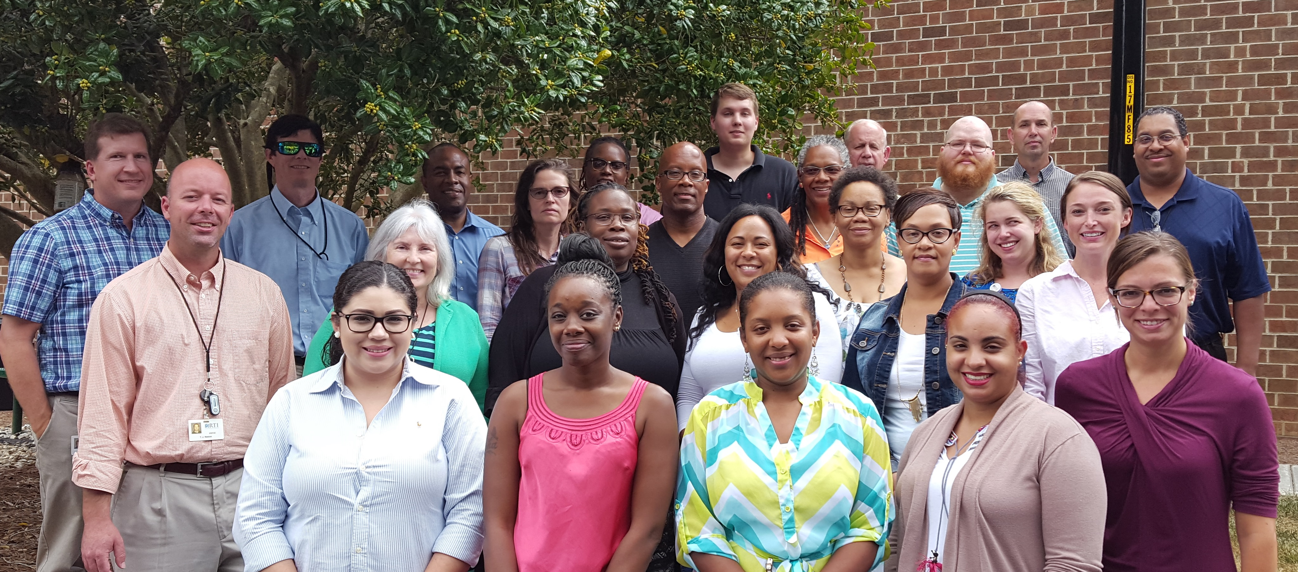
IPEDS Help Desk
Data Collection Help: 1-877-225-2568; ipedshelp@rti.org
Data Tools Help: 1-866-558-0658; ipedstools@rti.org

Slide 134
Help Desk Activity 2016-17
 | Fall 2016 collection (includes registration) | Winter 2016-17 collection | Spring 2017 collection | Total
Inbound calls | 7,698 | 10,857 | 8,800* | 27,355*
Outbound calls | 7,562 | 8,152 | 8,100* | 23,814*
Number of emails received | 4,383 | 5,721 | 6,200* | 16,304*
Total | 19,643 | 24,730 | 23,100* | 67,473*
* Projected

Slide 135
Training
Tinsley Smith, Association for Institutional Research
Resources

Slide 136
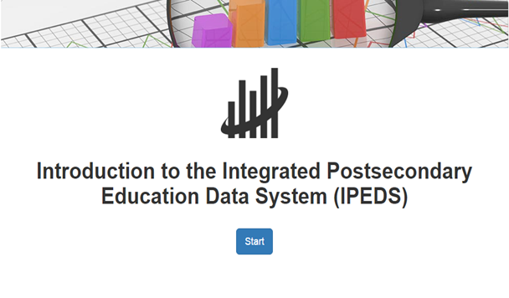
Distance Learning Dataset Training System (DLDT)
Introduction to the Integrated Postsecondary Education Data System (IPEDS)
Getting Started with the IPEDS Data
Data Collected Through the IPEDS
IPEDS Statutory Requirements, Data Collection Procedures, Universe, Levels of Analysis, and Missing Data
Considerations for Analysis of IPEDS Data
Available on the IPEDS Use the Data page under the ‘Overview of IPEDS Data’ link

Slide 137
Training
Association for Institutional Research (AIR)
Holds the subcontract for IPEDS training
Provides training in a variety of modalities:
Face-to-Face IPEDS Workshops
Online IPEDS Video Tutorials
Online IPEDS Keyholder Courses
NCES Data Institute (NDI)
www.airweb.org/IPEDS

Slide 138
AIR’s IPEDS Educator Cohort
30 higher education professionals from different sectors and regions of the country
State coordinators make great IPEDS Educators, contact Tinsley Smith at AIR for more information

Slide 139
Educator Roles & Opportunities - Based on Experience and Expertise
Keyholder Course Mentors
Provide support for data providers enrolled in 2 online courses:
Lead Instructors
Lead Workshop presentations
Educators with prior presentation skills at the national level and thorough knowledge of IPEDS
Assistant Instructors
Support Lead Instructors
Assist with hands-on exercises, managing onsite logistics, and conducting the evaluation process
Curricula Developers
Assist AIR in developing and updating Workshops
Typically work in teams of 4 to create, maintain, and update all Workshop materials
Essentials (less than 9 months)
Efficiencies (10-24 months)

Slide 140
Face-to-Face Workshops
30 Workshops Annually
Workshops Topics
New Keyholder Training
Best Practices for Reporting and Using IPEDS Data to Improve Efficiencies
IPEDS Data as the Public Face of an Institution
IPEDS Data and Benchmarking: Supporting Decision Making and Institutional Effectiveness
IPEDS Finance Survey Training
Most co-hosted with other higher education organizations
Include instruction, videos, hands-on exercises, and discussions
IPEDS Human Resources Survey Training – available Fall 2017
IPEDS Student Financial Aid Survey Training – available Fall 2017

Slide 141
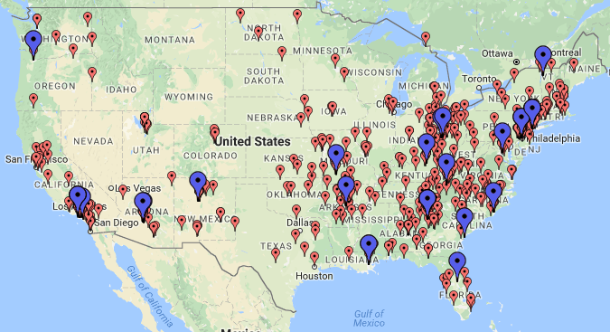
2015-16 Workshop Locations
741 participants, including over 450 keyholders and coordinators
94% of attendees agreed or strongly agreed that the workshop improved their knowledge of IPEDS

Slide 142
Online Video Tutorials
90 video tutorials
Over 6 ½ hours of educational content
19,094 page views
Survey Components
IPEDS definitions, concepts, and issues
Linked from Data Collection Survey screens
Data Tools
Provided instruction and demonstration for using tools effectively
IPEDS Related
New Keyholder & Annual IPEDS Update tutorials
Additional tutorials related to IPEDS materials
Tutorials discuss the benefits of each tool
48 concept tutorials
12 component overview tutorials
Data Release Stages, IPEDS Community, Net Price Calculator

Slide 143
Online Keyholder Courses
IPEDS Keyholder Essentials: A Beginner’s Guide
Data providers with less than 9 months of experience
Basic concepts, knowledge, and skills to complete IPEDS submissions
Provide resources needed to be successful in the keyholder role
Tips and tricks on how to complete accurate and timely IPEDS submissions
IPEDS Keyholder Efficiencies: Reducing the Reporting Burden
Data providers with 10-24 months of experience
Introduces and expands upon concepts for IPEDS Keyholders, including: cleaning data files, leveraging IPEDS data at your institution, reducing the burden of IPEDS reporting with process management and reporting, benchmarking data, and creating benchmarking reports
Launched September 2016

Slide 144
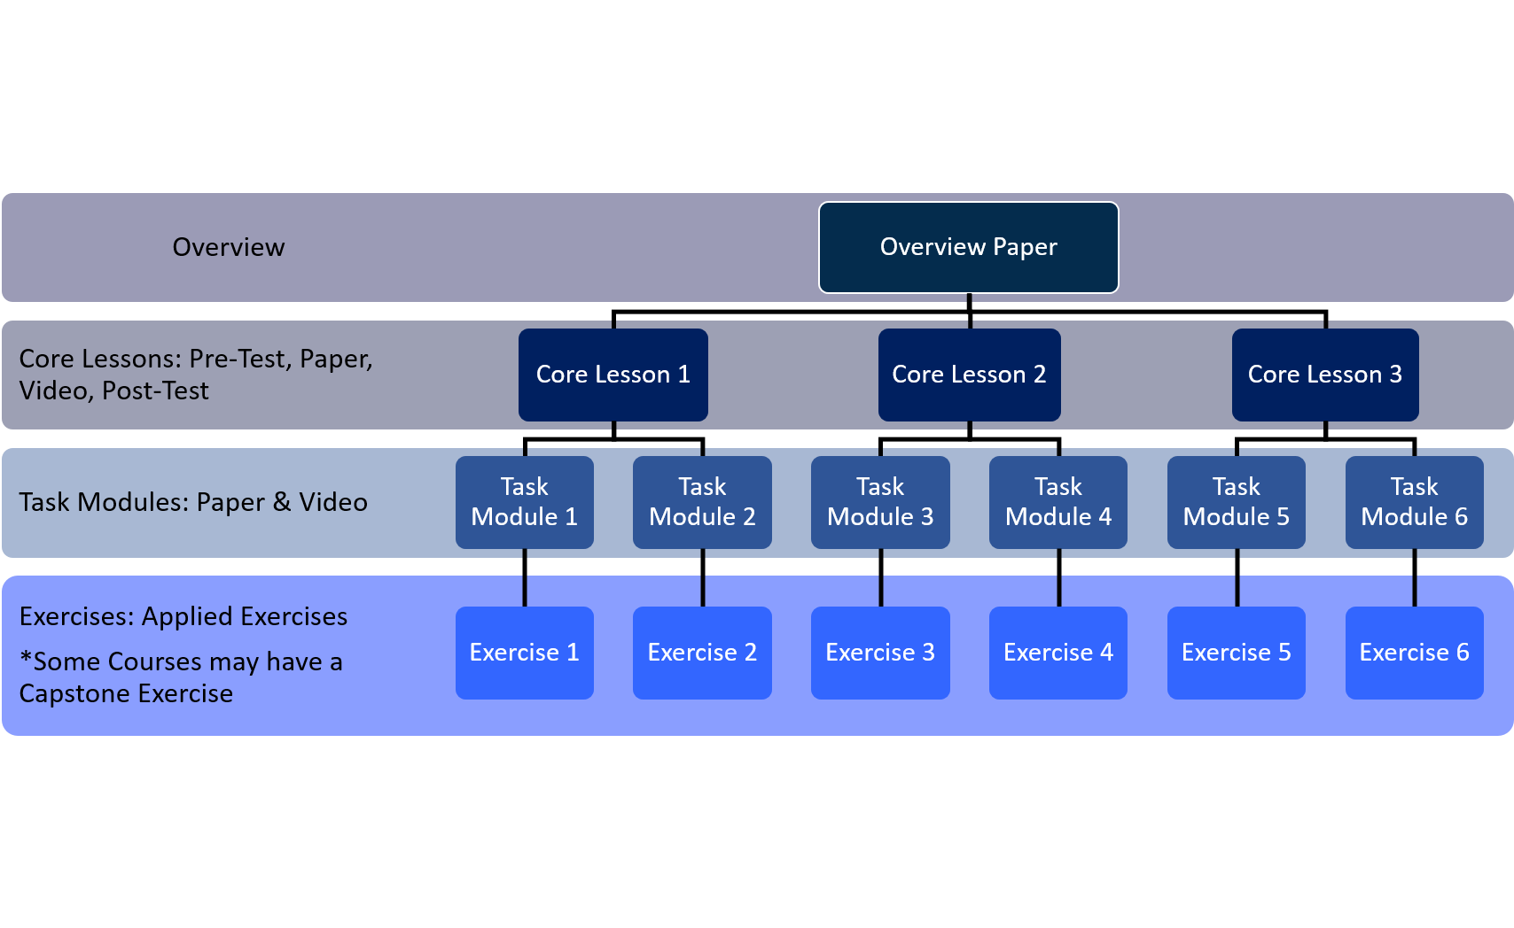
Online Keyholder Courses – Structure
Courses are non linear, but only take one course at a time
Pre-register via online sign up on AIR’s website
1 month to complete 10-12 hours of content
Self-paced and mentor supported

Slide 145
Course Enrollment/Completion
IPEDS Keyholder Essentials | # Registrants | % Completed
September 2016 | 30 | 57%
October 2016 | 36 | 33%
November 2016 | 52 | 38%
February 2017 | 61 | 49%
March 2017 | 80 | 56%
TOTAL | 259 | 47%
IPEDS Keyholder Efficiencies | # Registrants | % Completed
September 2016 | 30 | 53%
October 2016 | 35 | 26%
November 2016 | 50 | 70%
February 2017 | 59 | 46%
March 2017 | 41 | 41%
TOTAL | 215 | 47%

Slide 146
NCES Data Institute (NDI)
June 12 – 14, 2017: Face-to-Face Meeting
In Development: NDI Online Course
Exponentially increase access
Content includes presentations and lectures that provide 30 participants with an overview of NCES and detailed instruction on NCES datasets and tools, such as weighting, confidentiality, and restricted use licensing protocols
Enhances and maximizes face-to-face meeting time for small cohort of 30
Increase likelihood of attendees producing scholarly and publishable research
Timeline:
Summer 2017 – pilot testing
November 2017 - National launch

Slide 147
Data Release and Publications
Notes:
147
147

Slide 148
Data Release Procedure
Andrew Mary
Data Release and Publications

Slide 149
IPEDS Data Release Procedure
4 stages:
Collection Level
Preliminary
Provisional
Final
Outlined in IPEDS Resource Center

Slide 150
Collection Level
Data are locked
Then they are reviewed by the Help Desk
Then they are migrated to the Collection Level data tools (login available only through the Data Collection System)
At Collection Level, any respondent whose data have already been migrated can see their own data, as well as the data for all of the other institutions that have already been migrated

Slide 151
Preliminary Data
After an IPEDS data collection cycle closes:
A First Look publication based on preliminary data is released
Preliminary data are made publicly available through the IPEDS data tools
Preliminary data have been edited but are subject to further NCES quality control procedures
Imputed data for nonresponding institutions are not included

Slide 152
Provisional Data
After all quality control procedures are complete:
The First Look publication is reissued based on the provisional data
Provisional data are made publicly available through the IPEDS data tools
Data have been imputed for non-responding institutions

Slide 153
Final Data
Institutions may submit revisions to data in the subsequent data collection year.
After editing of these revised data is complete:
Final data are made public through the IPEDS data tools
The First Look publication is not reissued

Slide 154
Publications and Reports
Andrew Mary
Data Release and Publications

Slide 155
Publication/Data Release Schedule
Preliminary Data [data released and First Look published]:
Fall Survey Data (ICH, IC, E12, C): late-May to early June following the collection
Winter Survey Data (SFA, ADM, GR, GR200, OM): late-September to mid-October following the collection
Spring Survey Data (HR, EF, F, AL): late-October to mid-November following the collection
Provisional Data [data released and First Look published]:
Approximately 4-6 weeks after the Preliminary data release

Slide 156
IPEDS First Looks
What Is A First Look?
A brief publication and set of tables that coincides with the release of IPEDS data files.
Recent releases:
IPEDS Fall 2016-17 data collection (preliminary data)
Coming soon!
IPEDS Winter 2015-16 data collection (provisional data)
Pub #2017-084, 02/28/17
IPEDS Spring 2015-16 data collection (provisional data)
Pub #2017-024, 02/14/17

Slide 157
IPEDS Brochures
Bao Le
Data Release and Publications

Slide 158
Overview
Purpose
Public-friendly publications to inform about the IPEDS collection
Use plain language and graphics to explain complex ideas
Provide broad overview but also list resources for deeper dives
Audience
Policy makers
Hill staffers
Other federal agencies
College presidents
Members of the media
Beginning researchers

Slide 159
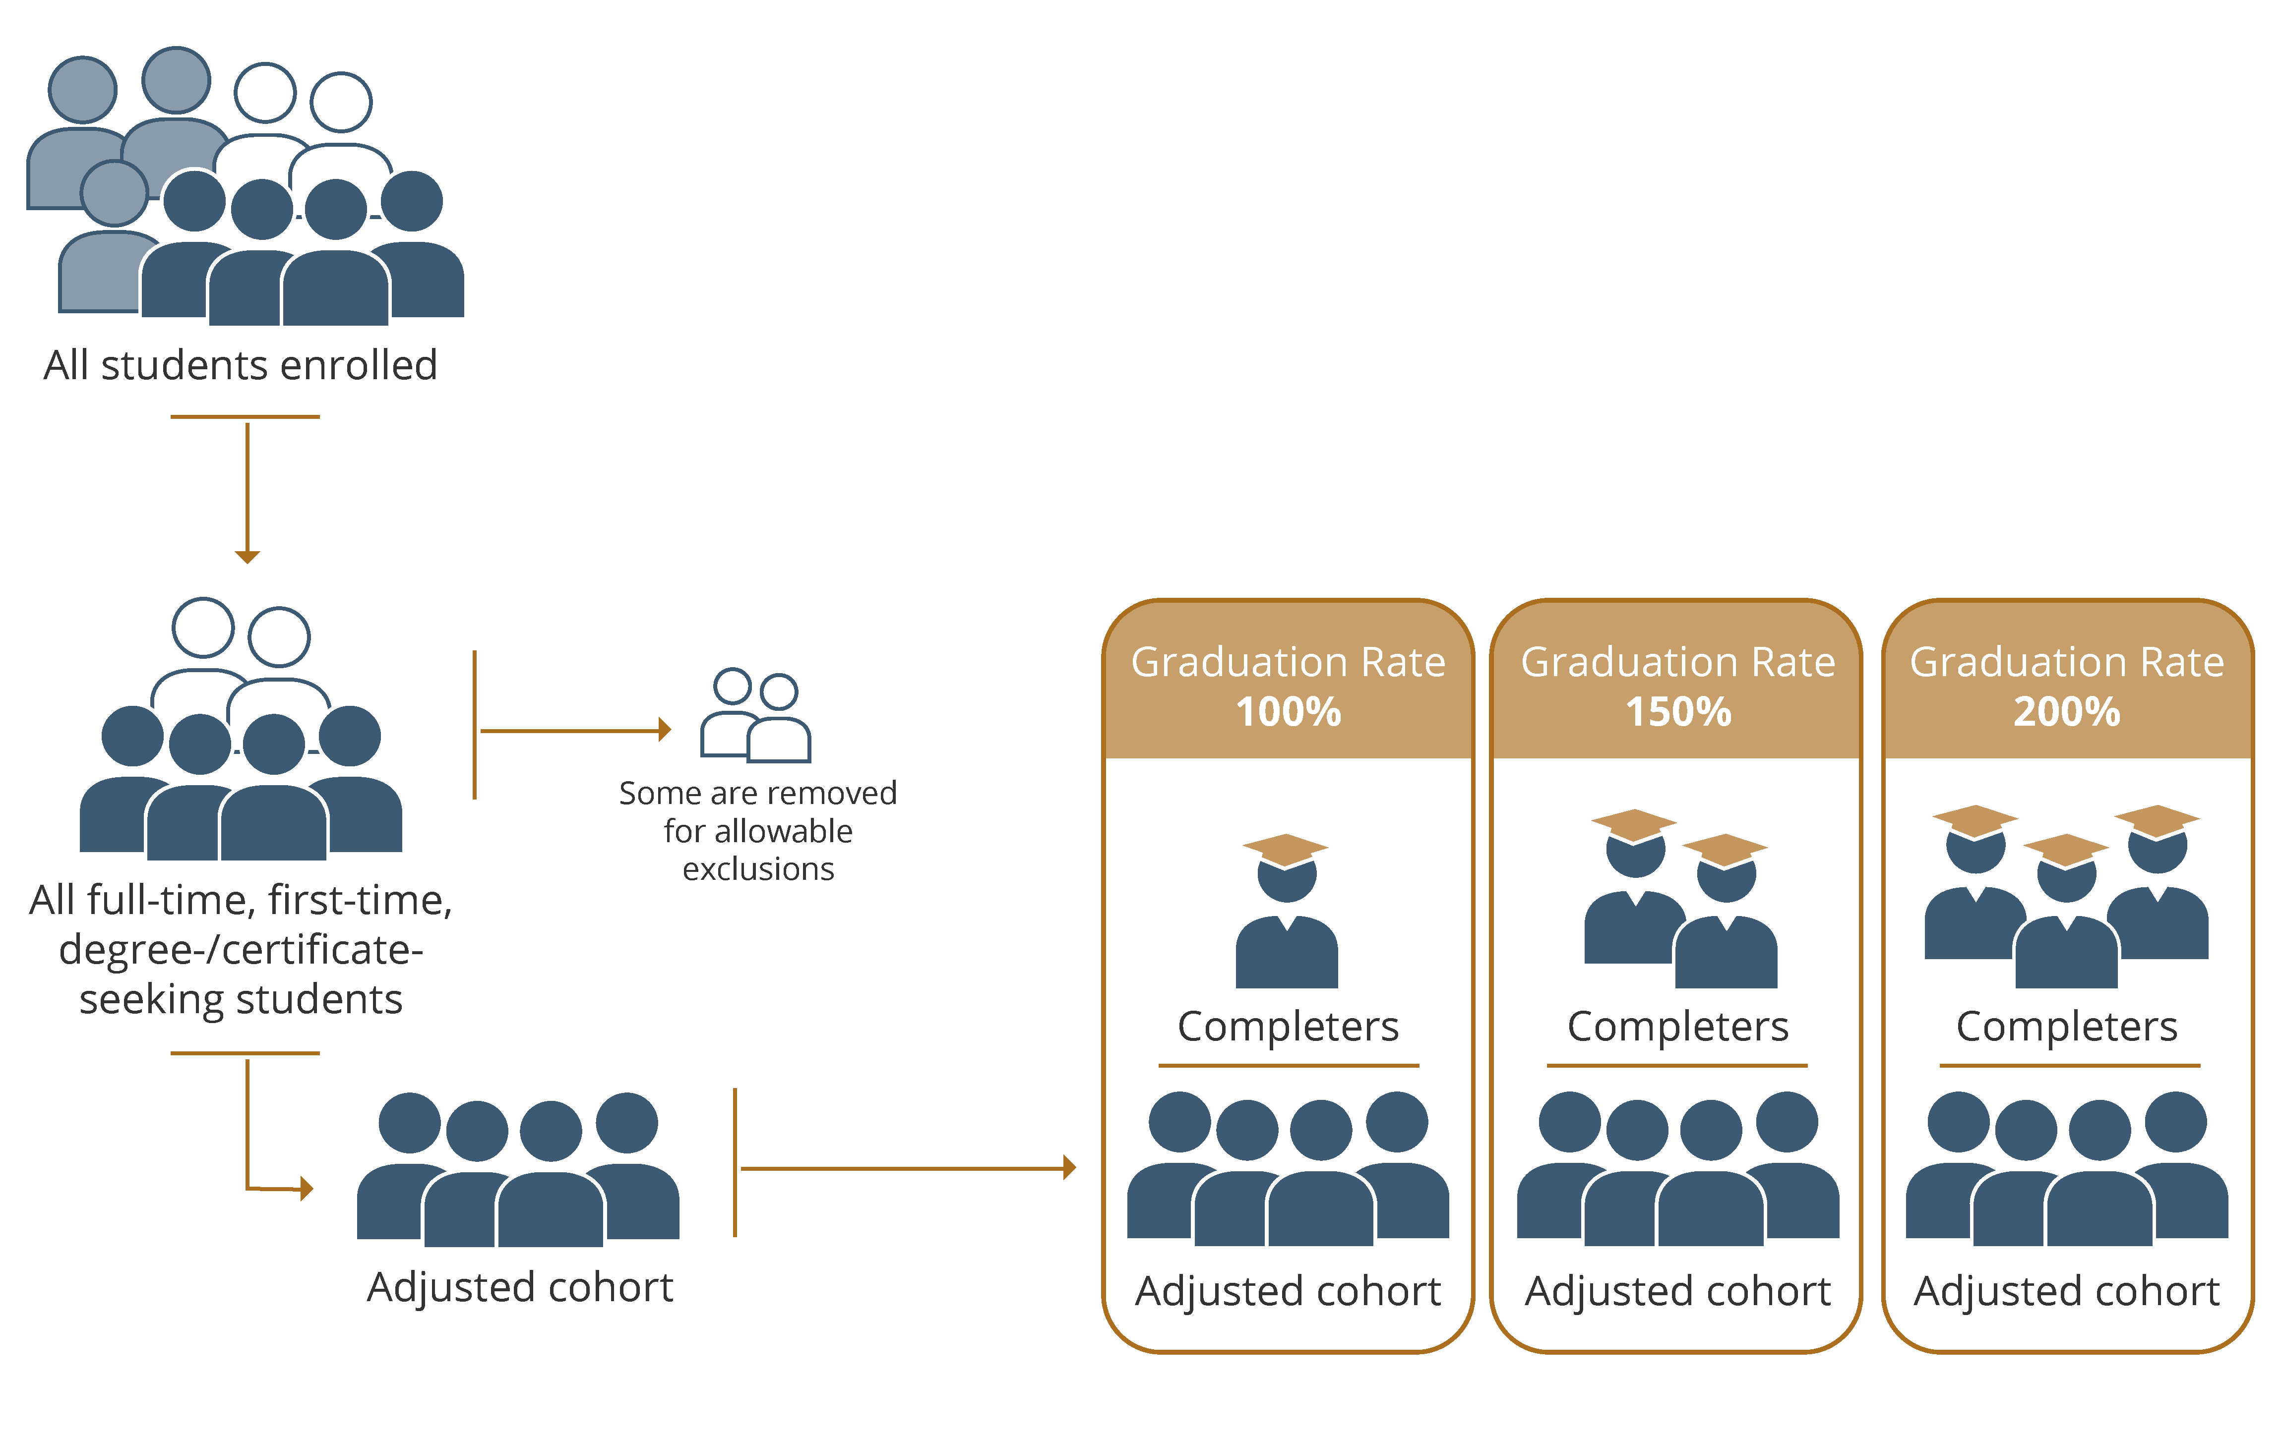

Slide 160
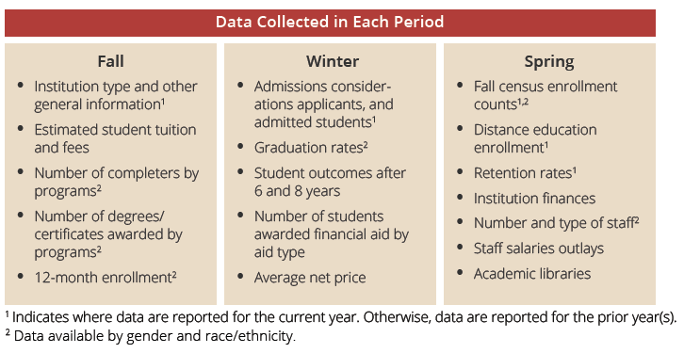

Slide 161
Dissemination Methods
Available for download as “Data Product” on Publications and Products page (https://nces.ed.gov/pubsearch/getpubcats.asp?sid=010)
Distributed at conferences

Slide 162
Future Topic: NCES Postsecondary Surveys

Slide 163
Future Topic: Enrollment

Slide 164
Other Future Topics
Data Collection & Dissemination Processes
Student Financial Aid
Completions
Outcome Measures
Use the Data functions
IPEDS statistics (derived variables, other analyses available)

Slide 165
Data Center
Sam Barbett
IPEDS Use the Data Tools

Slide 166
Use the Data

Slide 167
Data Access Page

Slide 168
Data Access
Functions that use provisional/preliminary and final data based on selection on data access page
Compare Institutions
Statistical Tables
Survey Data Custom Data Files
Functions that use provisional data only
Data Trends
Data Feedback Report
Look up an Institution (Reported data)

Slide 169
Data Access
Other Functions
Summary Tables – Will only have the latest released data (preliminary/provisional/final) as they get released.
Survey Data Complete Data Files. Downloadable zip files will contain both provisional and final releases, when final becomes available becomes available
Look up an Institution (Profile) . Displays only the latest current year released data preliminary or provisional.

Slide 170
New Variables in the Collection Level Data Center

Slide 171
Use the Data

Slide 172
Collection Level

Slide 173
Collection Level – selecting institutions

Slide 174
Collection Level – Surveys

Slide 175
Collection Level – Admission Considerations

Slide 176
Collection Level Admission Considerations

Slide 177
Admissions Test Scores – Writing scores eliminated

Slide 178
Collection Level – Graduation rate data for Pell Grant and Stafford Loan Recipients

Slide 179
Collection Level – Graduation rate data for Pell Grant and Stafford Loan Recipients

Slide 180
Collection Level – Graduation rate data for Pell Grant and Stafford Loan Recipients

Slide 181
Collection Level – Finance expenses for all institutions

Slide 182
Collection Level – Finance Statement of financial position for GASB institutions

Slide 183
Collection Level – Academic Library Collections

Slide 184
Collection Level – Human Resources Salaries

Slide 185
Human Resources – Changes for nontenured/not on tenure track

Slide 186
Human Resources – Changes for nontenured/not on tenure track

Slide 187
Data Trends (trend generator 3.0)
Sam Barbett
IPEDS Use the Data Tools

Slide 188
Data Trends – updated to 2015-16

Slide 189
Data Trends – updated to 2015-16

Slide 190
Data Trends – updated to 2015-16

Slide 191
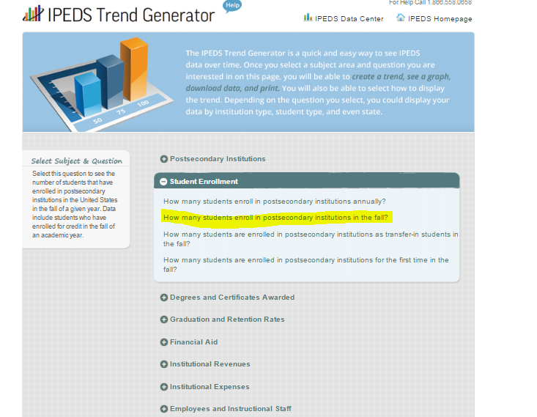
Data Trends – Fall enrollment

Slide 192
Data Trends – Fall enrollment

Slide 193
Data Trends – filtering/limiting results

Slide 194
Data Trends – filtering, limiting results

Slide 195
Data Trends – building a table, rows

Slide 196
Data Trends – building a table, columns

Slide 197
Data Trends - trend rows, columns or cells

Slide 198
Data Trends – trending rows

Slide 199
Data Feedback Report
Gigi Jones
IPEDS Use the Data Tools

Slide 200
Data Feedback Report

Slide 201
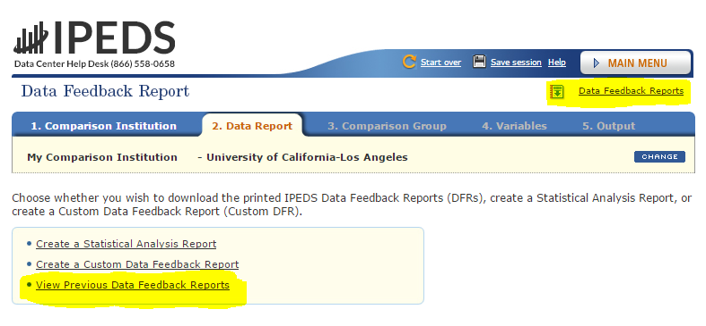
Changes to 2016 Data Feedback Reports
Table of Contents (inside cover)
Expansion of the Graduation rate and retention rate graph
Methodology (appendix) redesigned for easier read

Slide 202
Data Feedback Report
DFRs were sent to Keyholders and Coordinators on 3/8/17. They will be sent to CEOs on 3/21/17.
The 2016 DFR is based on data submitted to IPEDS in 2015-16.
Upload a new Custom Comparison Group for the 2017 Data Feedback Report
4/1/17 through 7/15/17

Slide 203
Downloadable database
Moussa Ezzeddine
IPEDS Use the Data Tools

Slide 204
Downloadable Database
On the main page, located under the ‘Survey Data’ drop down menu, which includes Complete and Custom Data Files.

Slide 205
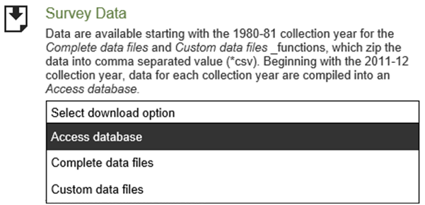
Downloadable Database

Slide 206
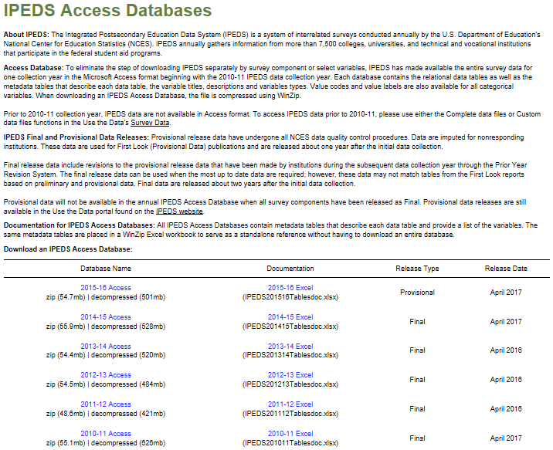
Downloadable Database

Slide 207
Downloadable Database

Slide 208
Downloadable Database

Slide 209
Questions?
About anything…

Slide 210
Thank you!

