Slide 1
Why VRPM?
Notes:
Rebecca

Slide 2
What’s the Problem?
The VRPM initiative is not based on any major flaw or problem with existing SMP & SHIP methods for involving volunteers and team members.
Instead, it is a pathway for enhanced quality, effectiveness, and safety.
Notes:
Rebecca. “The Senior Medicare Patrol (SMP) and State Health Insurance Assistance Program (SHIP) rely on volunteers to serve the Medicare beneficiaries within their states and territories. Without sound volunteer policies, there are inherent risks to the SMPs and SHIPs in recruiting and using these volunteers … [the] volunteer policies are designed to establish and organize the structure and operation of volunteer programs within the SMP/SHIP.”
“…though volunteers donate their time, they cannot accurately and safely serve often-vulnerable beneficiaries without training, support, and monitoring. Given Medicare’s complexities and the reality of volunteer turnover, SHIPs must dedicate year-round resources to recruiting volunteers and managing their volunteer programs.”
“The purpose of these volunteer policies is to enhance the quality, effectiveness, and safety of SMP/SHIP services through the provision of guidance and direction to SMP/SHIP staff and volunteers.”

Slide 3
Why Do We Need National Policies?
As the SHIP and SMP program’s public profile grows it becomes increasingly necessary to ensure that the national system for involving volunteers is effective, both to avoid possible problems now and to prepare for the future.
Notes:
Rebecca. ACL’s VRPM initiative is designed to help SHIPs face both of these challenges. The policies represent a state-of-the-art infrastructure and support system.

Slide 4
SHIP and SMP-Specific Challenges & Risks
Access to the personal information and the associated risk of abuse of that trust
Complexity of the counselor role, including:
High knowledge requirements
Possibility of unintentional mistakes
Need for delicacy in working with beneficiaries who want simple and easy answers
Difficulty in recruiting volunteers willing to donate the time required to assimilate the information necessary to perform counseling
The need to retain experienced volunteers to avoid the high costs of recruiting and training replacements
Notes:
Rebecca. Customize based upon your program structure.

Slide 5
The Changing National Environment for Volunteer Involvement
Greater risks associated with volunteering
Greater standards of accountability
Higher risk of theft and misuse of personal identity and financial data
More responsible roles being assumed by volunteers
Changes in the demographics of the volunteer population
Notes:
Rebecca.

Slide 6
Being Proactive = Sound Program Management
The VRPM initiative is based on the well-tested best practices of many other volunteer programs across America and beyond.
The Policies are designed to:
Improve program quality and client service
Ensure continuity over time
Promote equity and standardization
Notes:
Rebecca. We need to review our system for involving volunteers and upgrade where necessary. We cannot assume that what worked yesterday (or today) is necessarily going to work tomorrow.

Slide 7
Risk Management
Defines expectations and rules
Acts as guides to action and decision-making; they are indispensable in the modern volunteer program.
Ensures that SHIP and SMP services are safer for beneficiaries and volunteers
Reduces volunteer-related liability exposure for programs and their partners.
Notes:
Rebecca. There is no doubt its adoption will enable SHIPs to more safely, effectively and productively manage volunteer involvement.

Slide 8
Growth with Quality
More effective engagement of volunteers will allow programs to provide a wider and safer set of services to program beneficiaries, allowing us to both grow and improve provision of valuable assistance.
We will have a greater assurance that what we offer, both directly and through our partner organizations, is of consistently high quality, and is as safe as possible for everyone concerned.
Notes:
Rebecca.

Slide 9
National Standard of Care
VRPM creates a consistent set of standards throughout the SHIP and SMP networks.
Safety in numbers: National standards clarify where the bar is set, thereby limiting liability for those programs that are in compliance with national standards. That, in turn, protects the reputation and public profile of the entire network.
Notes:
The initiative should enable SHIPs to compete effectively for the next generation volunteer workforce while also enhancing the effectiveness and work experience of current volunteers. We are building a safer, reliable and more unified and branded national profile.

Slide 10
VRPM Resources Tour
From the SMP and SHIP National Centers
Notes:
Ginny and Nicole

Slide 11
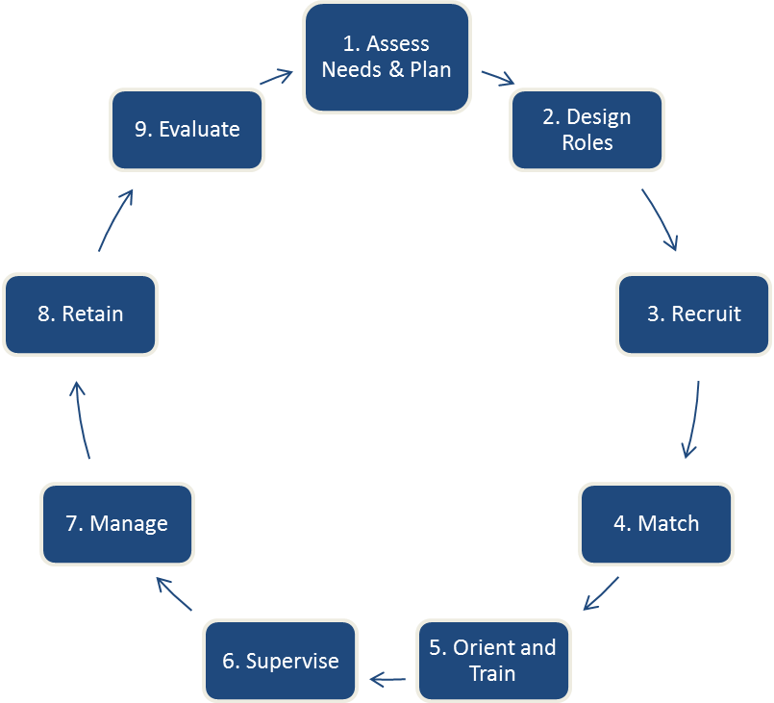
Volunteer Involvement Cycle
Notes:
Ginny. This cycle is the underpinning of the VRPM policies and the SMP and SHIP volunteer risk and program management infrastructure. The VRPM policies address all 9 phases of this process. This cycle is also featured in the beginning of the VRPM Policy Implementation Manual that you were provided.

Slide 12
ACL’s VRPM Policy Document
Introduction Covers:
Purpose
Table of Contents
Lists the categories of policies
Answers the question, “But what about paid and in-kind staff?”
How to use the policies
Lists key terms
Notes:
Ginny will use screen share to show the Conflict of interest policy as an example Required Policy. Notice there is the policy text. That is the required part. The rationale is to help with context. Some policies contain suggested procedures. Again, rationale and suggested procedures are to help you with implementation. Notice that Reference Checks are a recommended policy, whereas Background Checks and Criminal Records Checks are required. All of these policies are in the screening category. It is important to note that the definition of “Position of Trust” is important to setting up your screening policies and procedures. Let’s review that definition.

Slide 13
Important Companion Manuals
VRPM Policy Implementation Manual
Volunteer Program Management Manual
Understanding the requirements, their source, and due dates
Assessing your current program
Communicating with stakeholders
Has a companion Policy Implementation Kit
* For Program Leaders
How-to guide for day-to-day volunteer mgmt.
Many “Rs”: Roles, Recruitment, Retention, Recognition
Supervision (including for difficult situations)
*For Volunteer Managers
Notes:
Ginny. The VRPM term for a “volunteer manager” is “Coordinator of Volunteers”

Slide 14
VRPM Resource Groupings
Application Packet Resources
Complaint Reporting Resources
Dismissing a Volunteer Resources
Evaluation and Feedback Resources
Information Technology Resources
Interview Resources
Orientation and Training Resources
Performance Management Resources
Policy Implementation Kit
Recruitment, Retention, and Recognition Resources
Risk Assessment Resources
Risk Management, Health & Safety Resources
Role Description Resources
Role Development Resources
Screening Resources
Volunteer Program Management Manual
Welcome Packet Resources
SMPs: Library keyword search, such as for “VRPM Resource.” SHIPs: You can conduct the same library search Or, SHIPs, go to Toolbox > Coordinators of Volunteers > VRPM Resources Kit
Notes:
Ginny. VRPM resources are grouped together in the SHIP and SMP Resource Libraries by topic. Groupings include VRPM resources related to the specific topic, and also links to related resources within the library. Screen share of the SHIP Resource Groupings and the SMP Resource Groupings.

Slide 15
Some Policies Require State or Local Customization
Assess
Overarching customization issues
2.1: Risk Assessment
Develop
Local procedures
2.7, 2.10, 3.18, 3.25, 3.38, 3.42, 3.46, 3.58, 3.76, 3.77, 3.78, 3.81, 3.83, 3.85, 3.109, 4.1, 4.2
Write
Additional specifics
2.3, 3.15, and 4.5
Decide
What are your state minimums or maximums?
3.27 and 3.37
Note: Two Recommended policies also need to be customized if your program decides to use them – 2.11 and 3.39.
Notes:
Ginny. The resources we have outlined will help Twenty-three of the required VRPM policies must be customized for state-specific application, as described here.
One policy addresses overarching customization issues – 2.1: Risk assessment. This policy requires you to conduct a risk assessment every three years. It is up to you to determine the exact process for this risk assessment.
Some policies must be met to a certain minimum level, or minimum “threshold”; some policies have a maximum, or a ceiling limit level that cannot be exceeded. For example, in Policy 3.37: Background checks, you can decide how much volunteer experience or the amount/type of education an applicant needs for a given position.
Some policies will require you to develop local procedures that you and your volunteer host organizations will be following to implement these policies. For example, in Policy 2.10: Emergency contact procedures, you will need to determine a procedure that enables volunteers to communicate with supervisory personnel in case of an emergency.
There are some policies for which you may need to write additional specifics.
One example comes from Policy 4.5: Use of social media by volunteers. A list of suggested guidelines is provided in ACL’s policy document. However, you should review the list and add details and examples based on your program’s specific social media usage.
Two recommended policies also need to be customized if you decide to use them – 2.11: Disaster plan and 3.39: Driver’s license and record checks.
The SMP and SHIP Centers have worked together to produce, maintain, and update many resources and tools to help you implement the policies, including sample guidance, checklists, forms, and templates. We will talk about resources next.

Slide 16
VRPM Webinar Training for SMPs and SHIPs
Two spring VRPM webinars are offered annually (jointly)
To find recordings of past VRPM webinars, search the SHIP and SMP libraries for keywords “VRPM webinar”
You can search also by topic/category.
SHIPs: Activity = VRPM Type = Webinar Archive
SMPs: Type = Webinar Topic = VRPM

Slide 17
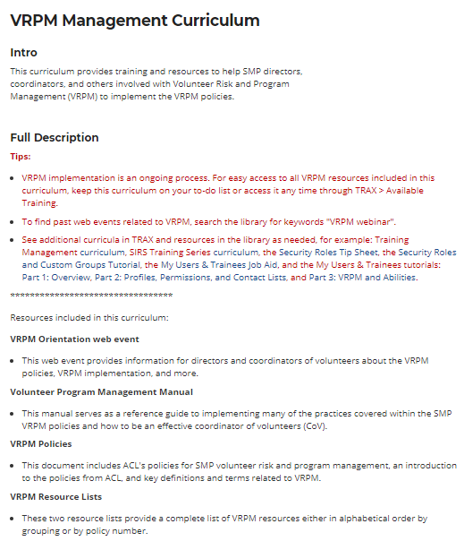
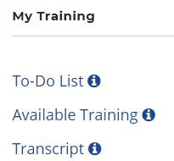
SMP-Specific
TRAX: VRPM Management Curriculum
This new curriculum provides training and resources to help SMP directors, coordinators, and others involved with VRPM to implement the policies. It includes the VRPM policies, resource groupings, VRPM Orientation web event, and more.
Log in at www.smpresource.org and go to TRAX > Available Training > Curriculum tab to view the curriculum and add it to your to-do list.

Slide 18
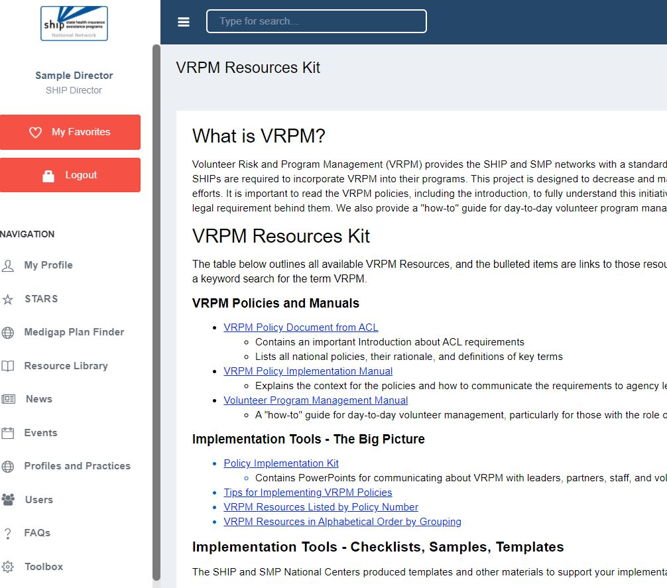
SHIP-Specific
VRPM Resources Kit
Log in and follow this path:
1. Toolbox
2. Coordinators of Volunteers
3. VRPM Resources Kit
Email VRPM questions to:
vrpm@shiptacenter.org

Slide 19
Start Here! Steps for New Directors
Read ACL’s VRPM Policy Introduction and the policies.
Review your program’s VRPM materials.
Identify and address gaps between national requirements and your program’s implementation.
Identify policies with recurring deadlines (ex. Risk assessment) and establish a plan to meet them.
Use the VRPM resources available in the SMP and SHIP libraries.
Notes:
As we discussed earlier, start by reading all of the policies… (read slide)
It’s important to keep in mind that VRPM is an ongoing process. If you are helping to continue VRPM implementation for your SMP and/or SHIP, you’ll need to find out which resources are currently being used, which ones have been customized for your state, which process your state follows for VRPM implementation, etc.

Slide 20
Questions?
This project was supported, in part by grant numbers 90SATC0002 and 90MPRC0002 from the U.S. Administration for Community Living, Department of Health and Human Services, Washington, D.C. 20201. Grantees undertaking projects under government sponsorship are encouraged to express freely their findings and conclusions. Points of view or opinions do not, therefore, necessarily represent official Administration for Community Living policy.

